Slide 1



Game Programming
AR Term Project
2017320121 이준구
2017320108 고재영

Slide 2
Presentation Contents
Project
Introduction
Demonstration Video
Team Coordination

Slide 3

01
Project Introduction

Slide 4





Project Introduction

Slide 5
Project Introduction
Select Plane
Confirm Plane
Press Start
Start Page
Play Game
Game Over

Slide 6
02
Demonstration Video

Slide 7
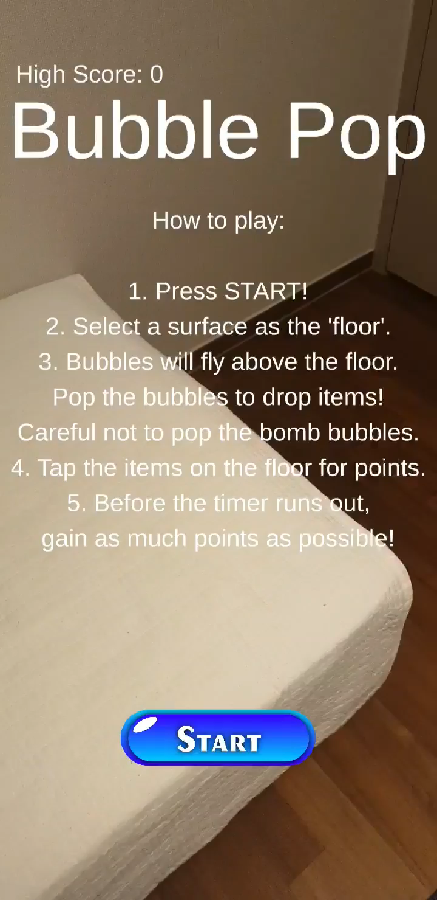
Demonstration Video

Slide 8
03
Team Coordination

Slide 9
Team Coordination
이준구
고재영
System Implementation
User Interface
Plane Detection
Game Progression
Object Control
Object Implementation
Bubble Related Scripts
Bubble Interaction with Environment
Bubble Spawn Position
Particle & Sound Effects

